Slide 1
PLAYER PERFORMANCE ANALYSIS WITH CLASSIFICATION & REGRESSION
ISHAK ORCUN AYDEMIR
UTKU OZYIGIT

Slide 2
player_stats
Our dataset includes 1,869 players and contains 8 features about them. The main feature we focus on is the "Rating", which we use to evaluate and compare players. In addition to the rating, the dataset includes: 'name', 'country', 'teams', 'total_maps', 'total_rounds', 'kd_diff', and 'kd'. Thanks to the Rating, we can understand whether a player is performing well or poorly. The rating itself is calculated based on several key factors:
Time Period (Performance over the last 3 months)
FirePower (Number of kills)
Entrying (Being the first player to enter and engage in a site)
Trading (The ability to trade a teammate’s death by immediately killing the opponent)
Clutching (Winning a round when left alone against multiple enemies)
Sniping (A crucial stat for players using sniper rifles)
Utility Usage (Use of grenades and other in-game utilities, which significantly impacts performance)

Slide 3
PLAYER STATISTICS (GOOD & BAD)
The average rating in our dataset is approximately 0.9858. Based on this value, we classify players as follows:
Players above the average rating are considered "Good" players,
Players equal to or below the average are considered "Bad" players.
In total, there are:
938 Good Players
931 Bad Players
This near-equal distribution confirms that our dataset is balanced, making it suitable for training unbiased classification models.
Since our dataset is balanced, no further resampling techniques were applied.

Slide 4
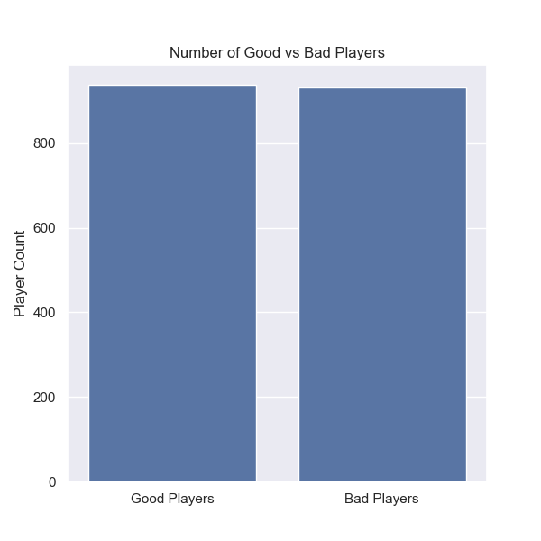
Here, we visualize the distribution of Good and Bad players, confirming the balance in class sizes.

Slide 5
MODEL PERFORMANCE EVALUATION
After classifying players as Good or Bad based on the average rating, we trained a Logistic Regression model to predict these labels using the remaining player statistics. We also applied Linear Regression to predict the exact player rating as a continuous value. Below are the performance results of both models:

Slide 6
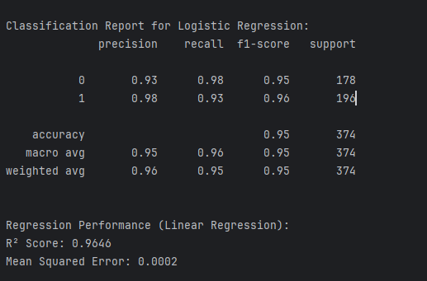

Slide 7
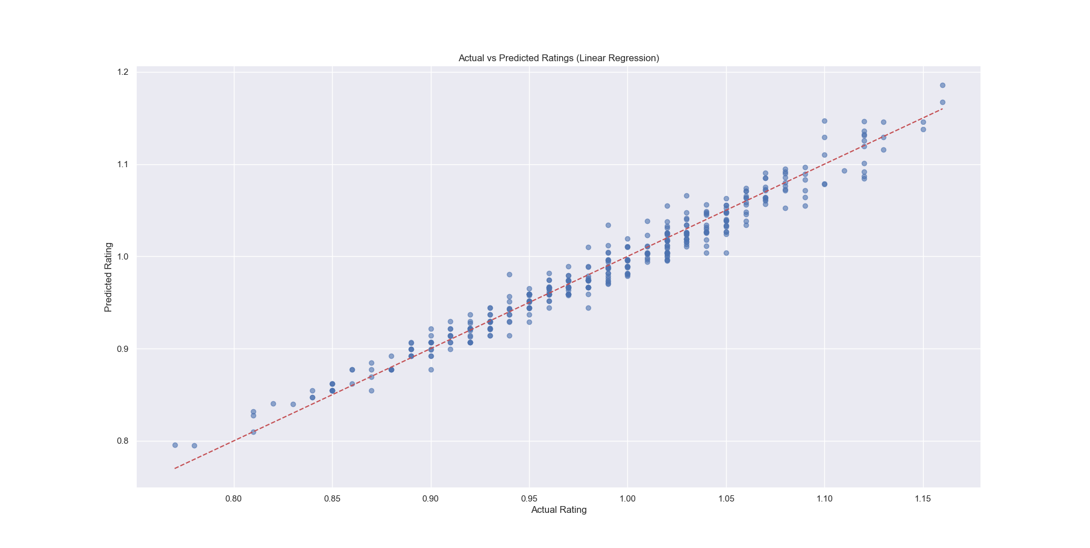
This scatter plot compares actual versus predicted ratings, where points close to the red dashed line indicate high prediction accuracy.

Slide 8
OVERALL EVALUATION
Our classification model effectively distinguishes between "Good" and "Bad" players with high accuracy. Precision, recall, and F1-score are consistently strong and balanced across both classes. The regression model accurately predicts players’ rating values, demonstrating strong predictive capability. The scatter plot shows that predicted ratings closely match the actual ratings; the red dashed line represents a perfect prediction. These results confirm that, based on our dataset, we can reliably classify player performance and predict their ratings.

Slide 9
THANK YOU FOR LISTENING

